Slide 1

Power BI Week 01 Part 02

Slide 2

Power BI W01 Part 2
1
Manage data relationships in Power BI
2
Calculated columns
3
Hierarchies
4
Date dimension in POWER BI
5
DAX
6
Calculated tables
7
Practice

Slide 3
Manage data relationships in Power BI

Slide 4
Manage data relationships in Power BI
Both-Directional relationship is one of the ways you can kill the performance of your Power BI Model!
Ambiguity might be very well hidden
Microsoft recommend using bi-directional filtering only as needed.
How to avoid both-directional relationships:
Method 1: Change the Data Model! Design Appropriately
Method 2: Using CrossFilter DAX function ONLY IF the first method does not work
http://radacad.com/what-is-the-direction-of-relationship-in-power-bi

Slide 5
Hierarchies

Slide 6
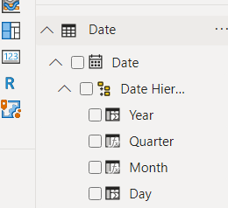
Hierarchies
Can help aggregate and show data on each level using Drill up and Drill down functions;
Use Drill Up and Drill Down for moving within one category;
Use Expand all for moving on the next level of hierarchy

Slide 7
DAX

Slide 8
DAX
What is DAX?
DAX is a collection of functions, operators, and constants that can be used in a formula, or expression, to calculate and return one or more values.
Aggregation Functions (SUM, MIN, MAX, AVERAGE etc): Total Sales=SUM(Sales[Revenue])
‘X’ Aggregation Functions (SUMX, MINX, MAXX, AVERAGEX etc): Total Sales=SUMX(Sales, [Sales]*[Quantity])
VAR Function
Time Intelligence Functions
Text Functions
Table Functions (FILTER, ALL, RELATEDTABLE, etc): USA Sales = FILTER (Sales, Sales[Country Name] = “USA”)
CALCULATE
https://docs.microsoft.com/ru-ru/dax/dax-function-reference

Slide 9
DAX
DAX Formatter - https://www.daxformatter.com/
DAX Course – https://www.sqlbi.com/p/introducing-dax-video-course/
https://www.youtube.com/playlist?list=PL1N57mwBHtN0JFoKSR0n-tBkUJHeMP2cP
https://docs.microsoft.com/en-us/learn/modules/create-measures-dax-power-bi/

Slide 10
Calculated tables

Slide 11
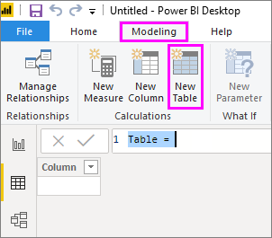
CALCULATED TABLES
Option to create a table using DAX function.
Example:
Calendar = CALENDAR (DATE (2005, 1, 1), DATE (2020, 12, 31))
Country = DISTINCT(Geography[Country])

Slide 12
Practice

